Slide 1

Data structures using C
Module 3 - Lecture VIII
Circular Link Lists
Prepared By
Ms. Smriti Sehgal

Slide 2
Deletion :
Deletion can be of three types.
▫ Delete from front
▫ Delete from last
▫ Deletion from mid
Note: deletion from mid in circular and linear linked list is exact same .

Slide 3
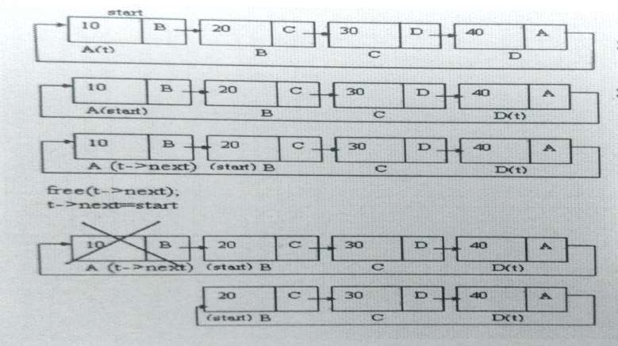
Delete from front

Slide 4
Algorithm for deletion from beginning
1 If (START == NULL)
Display( 'List is Empty!!! Deletion is not possible' )
Exit
Else
Temp1 = START
Temp2 = START
if(temp1 → next == START)
set START= NULL
delete temp1
else
while(temp1 → next is not equal to START)
temp1 = temp1 → next
2. START = temp2 → next
3. temp1 → next == START
4. delete temp2

Slide 5
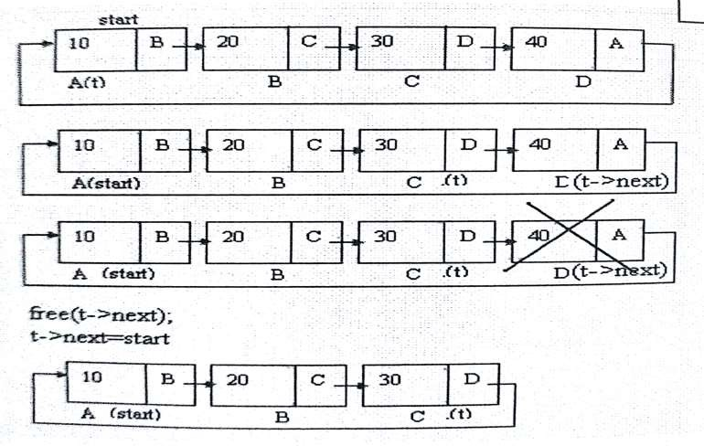
Delete from last

Slide 6
Algorithm
1 If (START == NULL)
Display( 'List is Empty!!! Deletion is not possible' )
Exit
2. Else
Temp1 = START
Temp2 = START
if(temp1 → next == START)
set START= NULL
delete temp1
d. else
Repeat Steps while(temp1 → next is not equal to START)
temp2 = temp1
temp1 = temp1 → next
3. temp2 → next == START
4. delete temp1

Slide 7
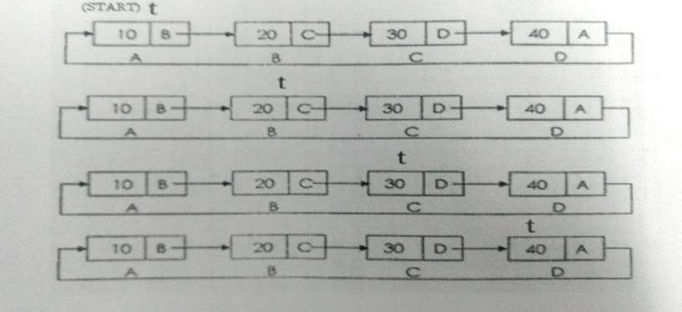
Display

Slide 8
Algorithm
If (START == NULL)
Display( 'List is Empty’ )
Exit
Else
Temp = START
Do
Display Temp → DATA
Temp = Temp → next
While(Temp is not equal to START)
Exit

Slide 9


